Slide 1

DevOps-Driven Deployment of a Dynamic Weather Dashboard Using Jenkins and Docker on AWS
NAME | ROLL NO | USN
Soham Mali | 22 | 02FE22BCI025
Pradeep Awubaigol | 27 | 02FE22BCI030
Aditya Koli | 03 | 02FE22BCI004
Afifa Shaikh | 04 | 02FE22BCI005
Course Coordinator: Prof. Neha Nimbalkar
DEPARTMENT OF COMPUTER SCIENCE AND ENGINEERING
Course Code : 24ECSE310 Academic year 2025
Department of Computer Science and Engineering,
KLE Technological University’s Dr. M. S. Sheshgiri College of Engineering and Technology, Belagavi
1/14

Slide 2
Table of content
Introduction
Motivation and Background
Problem Statement
Objectives
Methodology
Department of Computer Science and Engineering,
KLE Technological University’s Dr. M. S. Sheshgiri College of Engineering and Technology, Belagavi
2/14

Slide 3
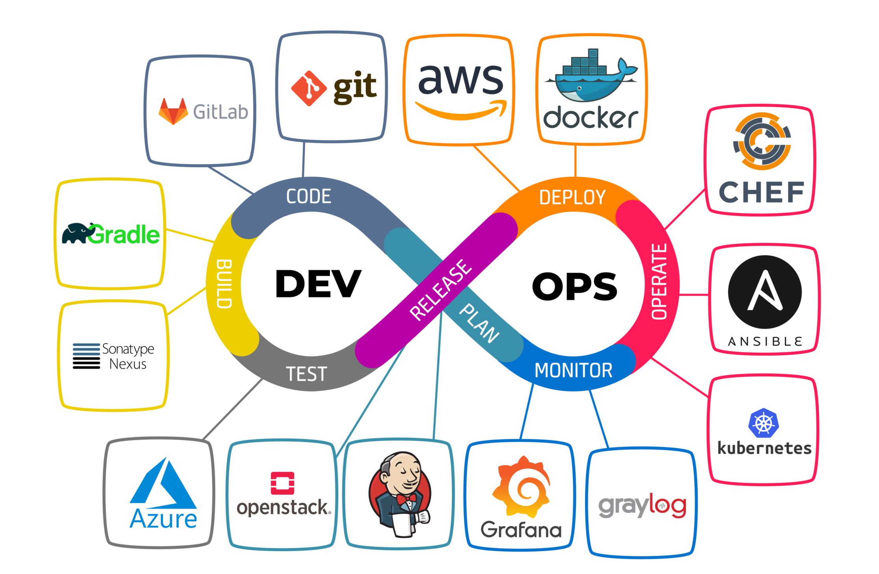
Introduction
Our project focuses on building a dynamic weather dashboard that provides real-time weather updates. The application will be deployed using modern DevOps tools like Jenkins and Docker for CI/CD (Continuous Integration/Continuous Delivery) and hosted on AWS for scalable, cloud-based infrastructure.
Department of Computer Science and Engineering,
KLE Technological University’s Dr. M. S. Sheshgiri College of Engineering and Technology, Belagavi
2/14

Slide 4
Motivation and Background
The motivation for this project arises from:
Automation in the deployment pipeline helps reduce human errors, improves consistency, and accelerates release cycles.
AWS provides a scalable infrastructure that can handle growing demand, ensuring the weather dashboard performs well even under high traffic.
In today’s fast-paced world, people rely on real-time information. Providing dynamic weather updates in a simple, intuitive dashboard is crucial for user engagement.

Slide 5
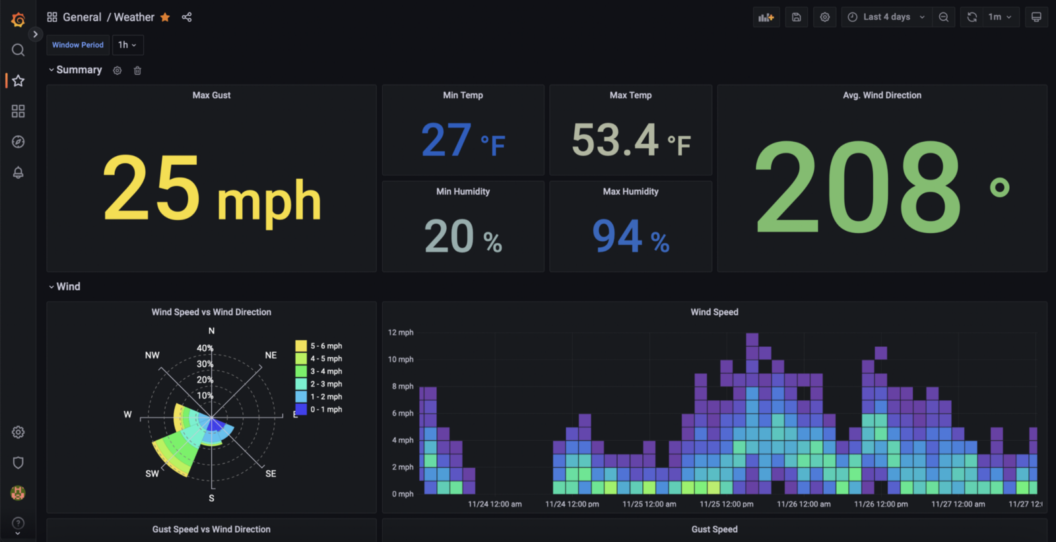
Problem Statement
Challenges with Current Methods:
Manual deployment of applications often leads to errors and downtime, which impacts user experience and productivity
Without cloud integration, handling large-scale traffic is difficult.
Lack of automation in building, testing, and deployment
Problem Statement: The goal is to automate the deployment of a dynamic weather dashboard using Jenkins, Docker, and AWS, enabling faster, more efficient updates and ensuring a smooth user experience.

Slide 6
Objectives
To Build an User Friendly Interface to view Weather Updates.
To Design a CI/CD Pipeline and containerize with Docker.
To Implement Real Time Weather Data Fetching.
Tools Usage:
GitHub: For Version control and collaboration.
Jenkins: This will Automates the process of building, testing, and deploying the application.
Docker: This Ensures consistency across different environments by containerizing the application.
AWS: For a scalable cloud environment for deploying the application.

Slide 7
Acknowledgements
Thank You!

